Slide 1



Mapping of Crustal Magnetic Fields on the Moon
Cecilyn Bustamante Torres, Dr. Lon Hood, UA/NASA Space Grant
29th Annual Arizona Space Grant Consortium Symposium/Tucson, AZ
April 18, 2020

Slide 2
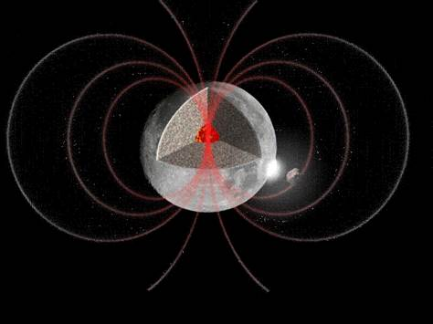
Introduction
The Moon possessed a dynamo magnetic field but it has died away.
Magnetic field anomalies remain and are produced by magnetized material in the lunar crust.
Observed magnetic field anomalies can be applied to construct contour maps to further investigate the nature of the sources and to presume the directions of magnetization.
M.-H. Deproost, ORB, Belgique

Slide 3
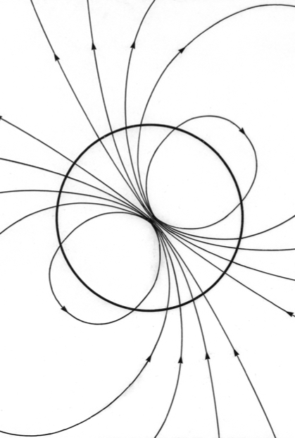
Terminology
What is a dipole?
  A system which consists of both positive and negative magnetic charges separated by a small distance.
What is a dipole moment?
  A measure of the strength and orientation of a magnetic dipole that produces a magnetic field. Higher order terms (such as the magnetic quadrupole moment) may be needed for more extended source bodies.
  It is a vector quantity whose direction runs from the south to the north pole of a magnetic source body.
  It’s magnitude determines the magnetic orientation and magnetic field strength.

Slide 4
Objective
Utilize the radial component of orbital magnetometer data from two missions (the NASA Lunar Prospector mission and the Japanese Kaguya mission) to produce contour maps of the lunar magnetic field at 30 km altitude using the Equivalent Source Dipole (ESD) technique.
In its simplest form, the ESD technique involves fitting the measured magnetic field at the variable spacecraft altitude to an array of vertically oriented magnetic dipoles at some depth beneath the lunar surface. Once all of the dipole moments are determined, the magnetic field can be calculated at a constant altitude.

Slide 5
Data Selection
A combination of orbital magnetometer data from the NASA Lunar Prospector mission (March 1999, May 1999) and the Japanese Kaguya mission (April-June 2009) was utilized.
  Only orbits at low altitudes were considered.
A total of 189 orbits were used to map the near side of the moon while 191 orbits were used for the far side.

Slide 6
Mapping Methods
Before applying the ESD technique, it is first necessary to minimize any contribution of external fields from the data.
A detrending filtering method was applied to the raw field data to minimize long-wavelength fields of non-lunar origin.
Stack-plots were then created to conduct careful visual editing of the orbits to further eliminate noise and short-wavelength variations that are not repeating on consecutive orbit passes.
  This is necessary as these fluctuations at high altitudes can be amplified by the Equivalent Source Dipole method when proceeding to lower altitudes.

Slide 7
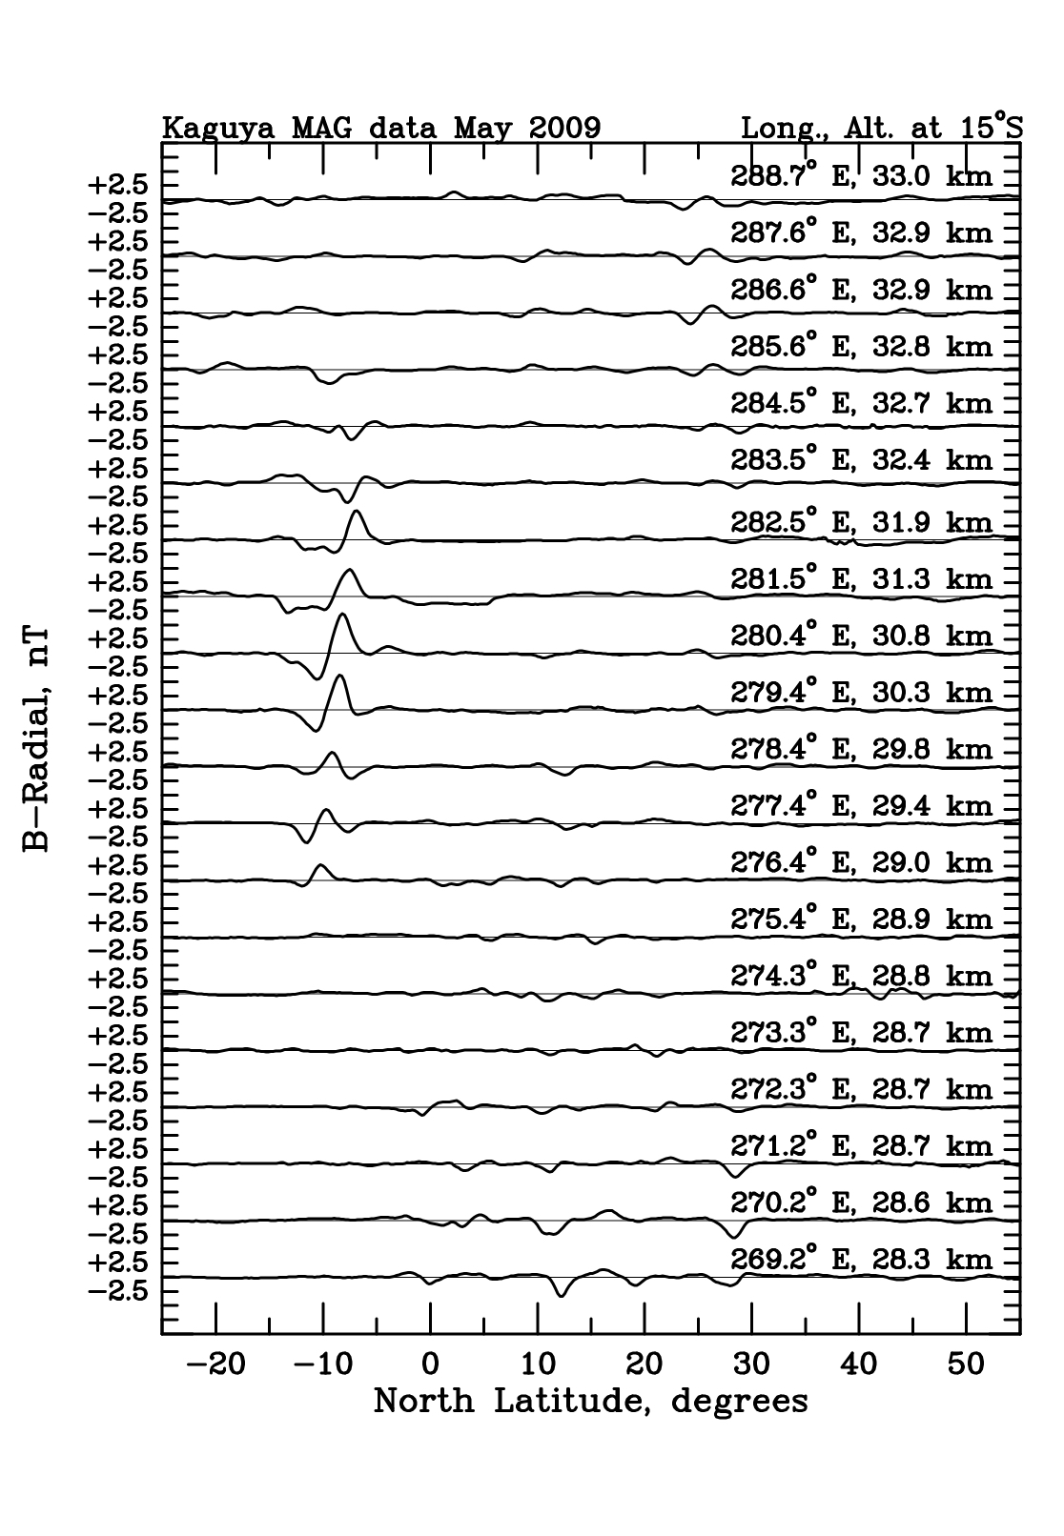
Mapping Methods (continued)
Figure 1.
Figure 1 demonstrates a sample stack-plot of Kaguya magnetometer data with repeating successive orbit passes indicating the presence of a magnetic anomaly.

Slide 8
Mapping Methods (continued)
The data are then sorted into bins according to field amplitude and two-dimensional filtering is applied. Sources are assumed to consist of an array of vertical dipoles separated on a spherical surface.
  This allows the field magnitude and the three vector field components (radial, north, and east) to be contour mapped at a constant altitude of 30 km.
  A dipole source depth of 15 km was found to produce a minimum RMS deviation of the observed radial field component from the ESD model radial field component.
The ESD technique is applied in a series of overlapping sectors covering 40 degrees of latitude and longitude to increase computational efficiency when solving for the moments of the dipole array.

Slide 9
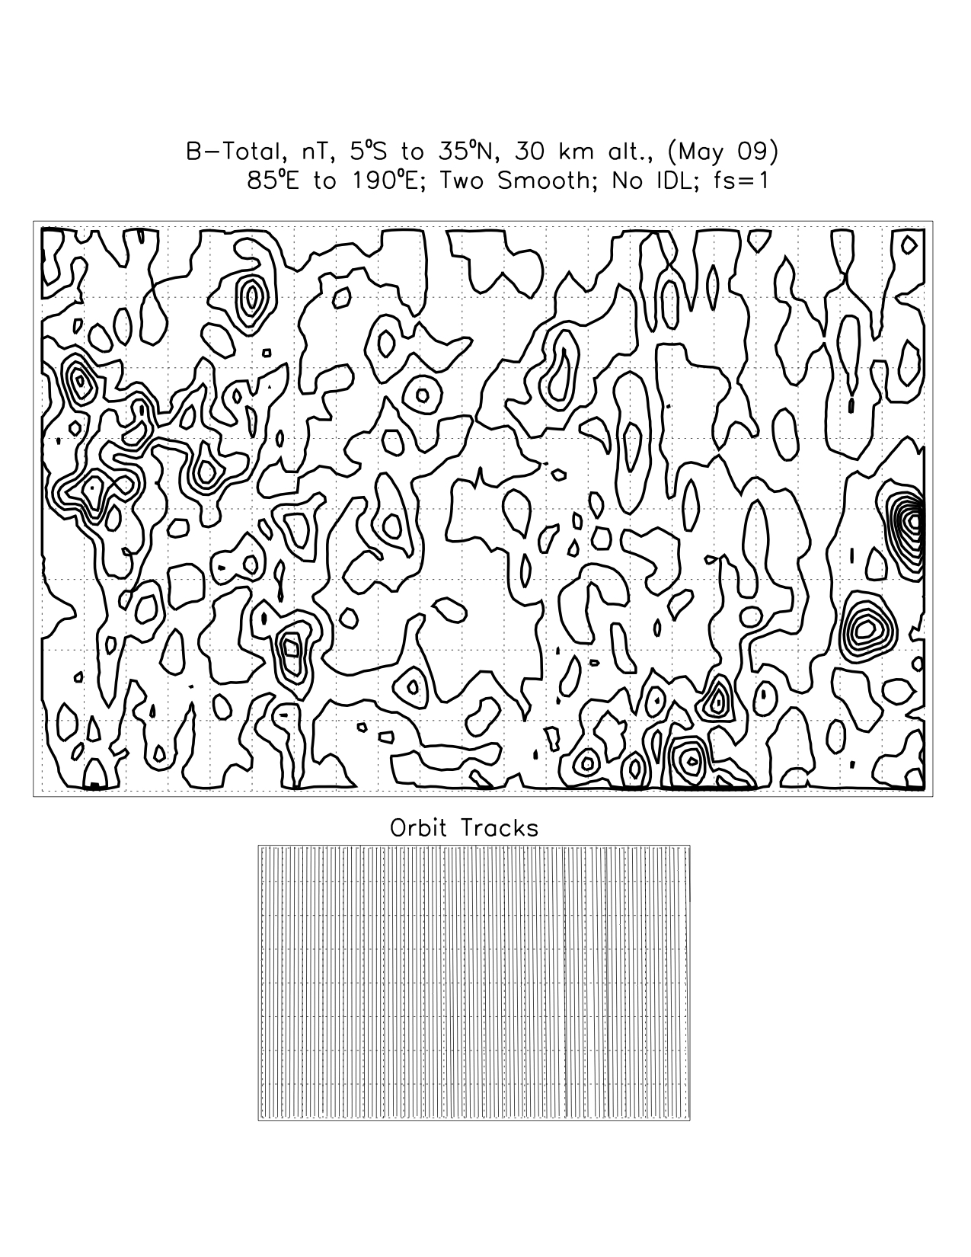
Results
Figure 2.
Figure 2 shows an example plot of the field magnitude (contour interval: 1 nanoTesla) at an altitude of 30 km computed from the dipole moment array.

Slide 10
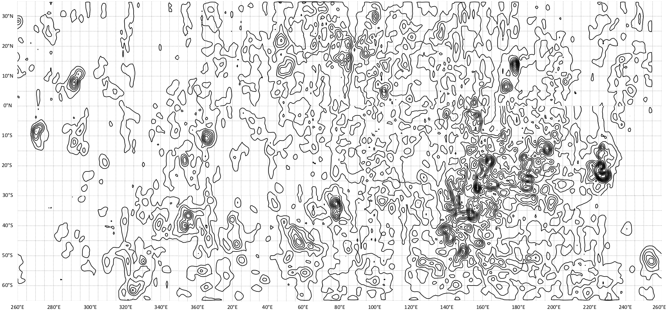
Results (continued)
The map above displays an example modeling of the lunar magnetic field at an altitude of 30 km (longitude range: 65°S to 35°N) calculated using the ESD technique. The contour interval for the radial field map is 1 nanoTesla.

Slide 11
Results (continued)
We are successfully mapping the lunar magnetic field by use of the Equivalent Source Dipole technique. This will aid future research concerning lunar magnetic anomalies and will be useful in planning future lunar missions.

Slide 12
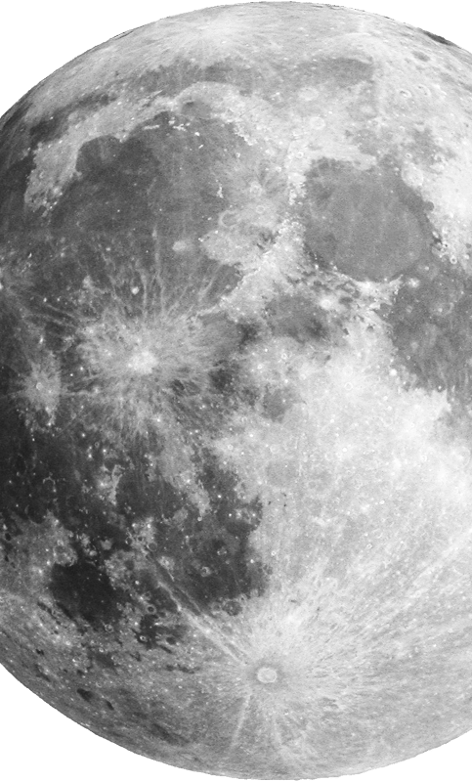
Impact
Associations with surface composition can help to differentiate between sources such as impact-produced material containing iron from the impactors that created large craters on the Moon.
  Magnetic anomalies may have been created when impactors intruded the lunar crust, transformed to liquid and melted, and underwent slow cooling.
  Deposited volcanic material has also been proposed as a source for the magnetic variations on the Moon.
  The location of the magnetic pole at the time a magnetic source body was formed can be estimated if the direction of magnetization can be determined and if the magnetizing field was generated in the Moon’s small iron core.
In sum, global mapping of the crustal magnetic fields on the Moon will allow better modeling and interpretation of lunar magnetic anomalies.

Slide 13
Acknowledgements
I would like to thank NASA and the Orbital Studies of Lunar Magnetism Grant as this work would not have been possible without their support.
I would also like to extend my deepest gratitude to my mentor, Dr. Lon Hood, for providing me invaluable guidance, encouragement and advice through each stage of the research process.
I offer my sincere appreciation to Michelle Coe (Manager), Chandra Holifield Collins (Associate Director), Yancy Shirley (Assistant Director), and the UA/NASA Space Grant Steering Committee for honoring me with the opportunity to gain professional experience that promoted personal and professional growth. Thank you for providing support, guidance and oversight of the UA/NASA Space Grant Program.

Slide 14
Thank You

